Slide 1
Airbnb Data Analysis
By Steve Novis, Jeremy Coy, Godday Ogbo, and Sanket Mishra
9/27/18

Slide 2
Motivation and Summary
Our goal for this project was to analyze and compare AirBnB statistics between cities in the US.
Because of its consistent and sudden growth in recent years, it has impacted the hotel industry in a big way and we felt that Airbnb would be an interesting topic to look at.
The cities we chose for this analysis are:
New York
San Francisco
Chicago
Austin

Slide 3
Motivation and Summary
In order to make comparisons between the cities, we asked ourselves a few questions:
What was each city’s average price per night?
Which cities have the highest rated Airbnbs?
Which neighborhoods in each city were the most expensive?
How available are each city’s Airbnbs?
Based on our analysis, we can say that we found sufficient data to answer these questions effectively.

Slide 4
Our Questions and Our Data
To find answers to our questions, we needed to find specific data to help answer them.
We used data from Inside Airbnb, an independent, non-commercial, open source data tool that analyzes Airbnb data for dozens of cities around the world.
The data we used for our analysis was pulled from its most recent analysis, August 2018.

Slide 5
Our Questions and Our Data
What was each city’s average price per night? Which cities were the most expensive on average?
Price per night for each Airbnb
Total number of Airbnb listings
Which cities have, on average, the highest rated Airbnbs? Which cities were more highly rated than others?
Overall ratings for each Airbnb
Total number of Airbnb listings

Slide 6
Our Questions and Our Data
Which neighborhoods in each city were the most expensive? How do they compare across cities?
A list of all neighborhoods in each city
The average price per night for each neighborhood
How available are each city’s Airbnbs? On average, how many times in the past year were Airbnbs available? Did it depend on the type of Airbnb?
The availability of each Airbnb for the past year (How many times were they open) and their availability on average for each city
The three different Airbnb room types: Entire homes/apartments, private rooms, and shared rooms
The average availability of each city based on room types.

Slide 7
Data Cleanup and Exploration
For our data cleanup and exploration, we each did our own searching and shared our findings with each other and gave input on how the data could help answer our questions.
Through our searching, we realized how extensive the data can get. The datasets that we used for our analysis were so large, we couldn’t include all the data in our analysis.
While we had originally tried to include hotel prices over time and Airbnb data over time to expand the range of our analysis work, our searches came up with insufficient hotel data, as well as insufficient historical data that we could use for our analysis.

Slide 8
Data Cleanup and Exploration
Here are some interesting data points that we found in our analysis:
Most expensive Airbnbs in each city:
New York: $10,000 per night
San Francisco: $ 2,400 per night
Chicago: $10,000 per night
Austin: $10,900 per night
Average cleanliness rating for each city:
New York: 9.26
San Francisco: 9.61
Chicago: 9.53
Austin: 9.63
Total Airbnbs in each city:
New York: 50,914
San Francisco: 6,633
Chicago: 7,776
Austin: 11,659

Slide 9
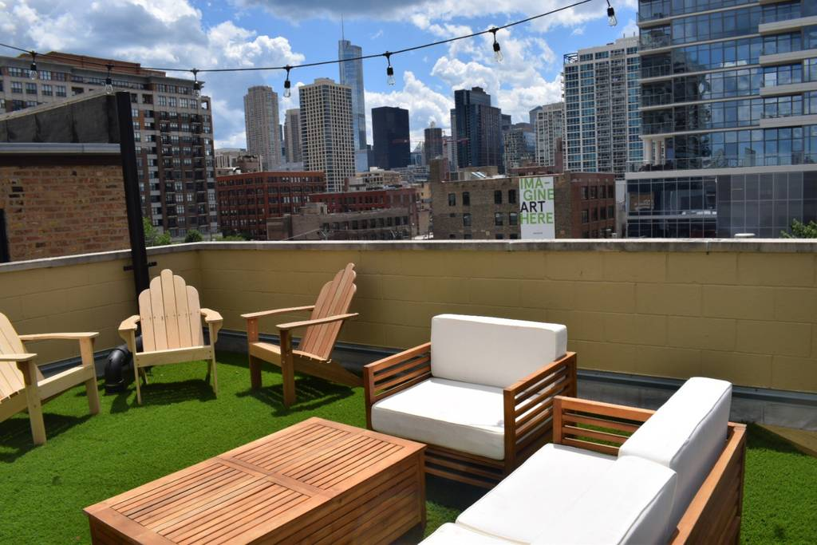
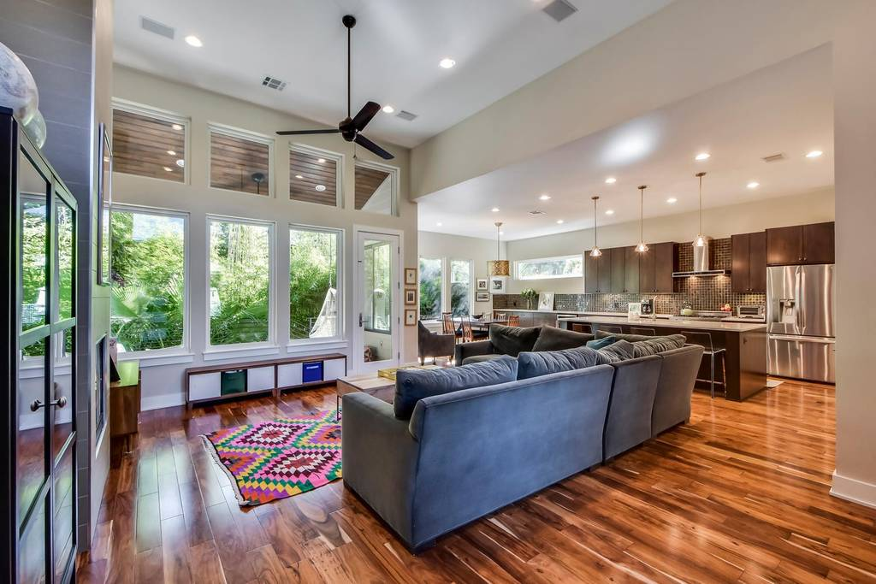
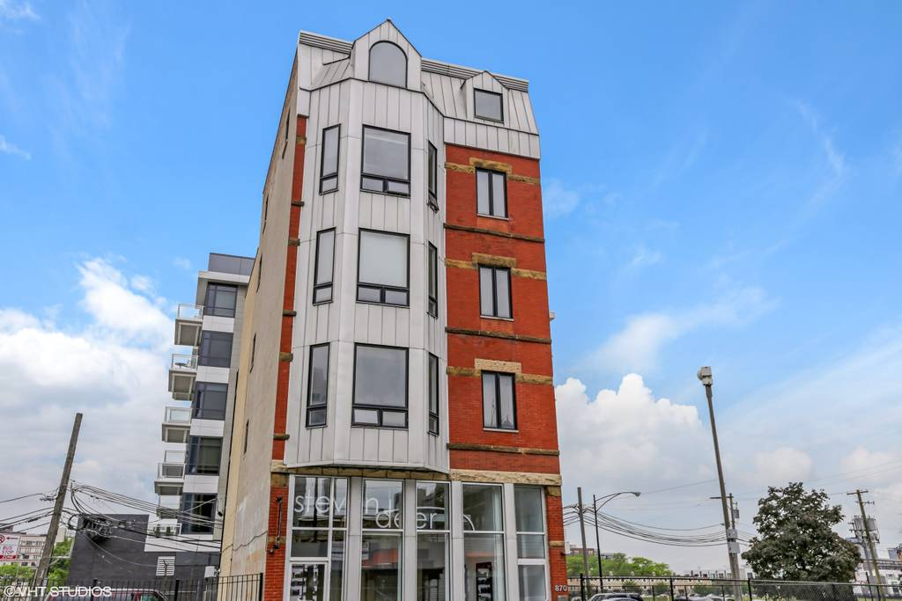
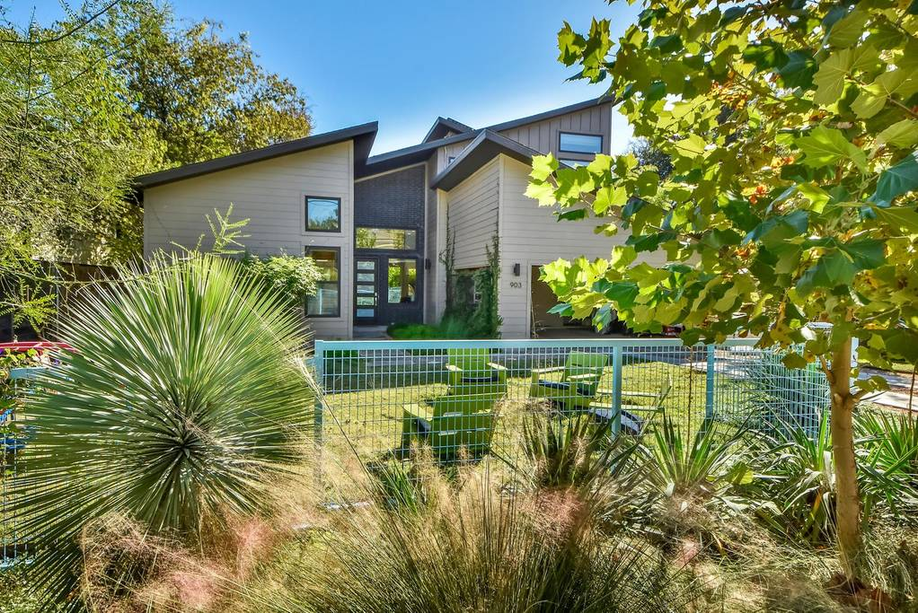
Most Expensive Airbnbs
Chicago - $10,000 per night
Austin - $10,900 per night

Slide 10
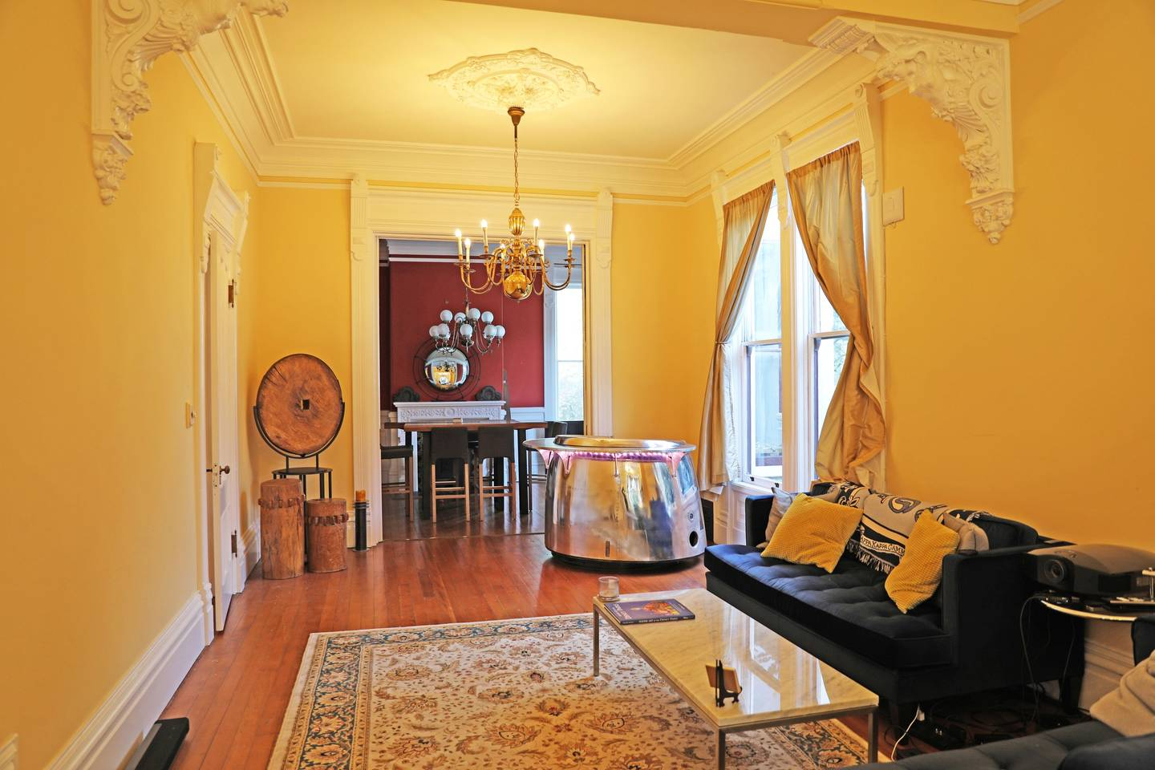
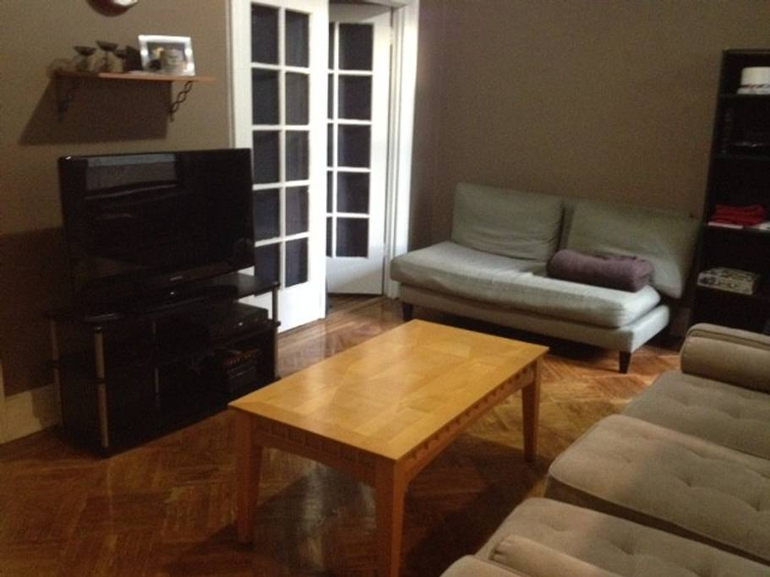
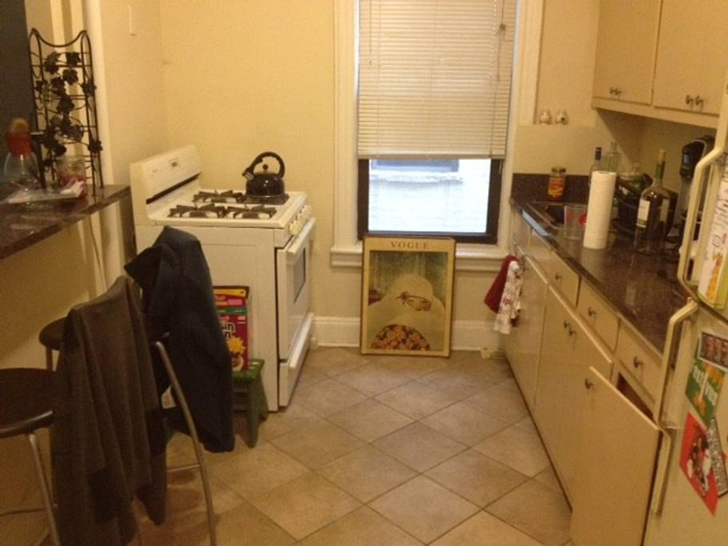
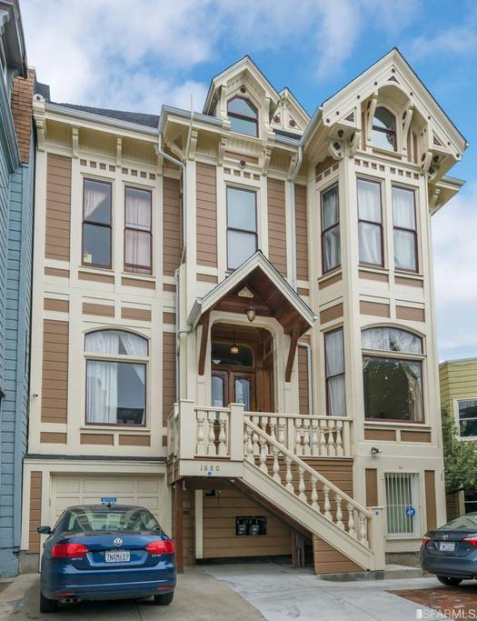
Most Expensive Airbnbs
New York - $10,000 per night
San Francisco - $2,400 per night

Slide 11
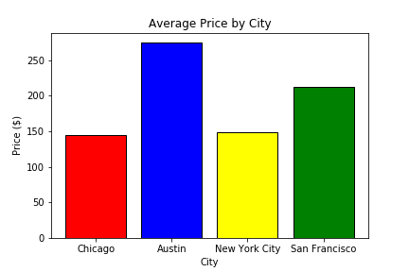
Data Analysis
What was each city’s average price per night?
This statistic was easy to find. We simply took the average price offering for all cities and compared the statistics.
Most expensive on average: Austin
$274.76 per night
Least expensive on average: Chicago
$144.11 per night

Slide 12
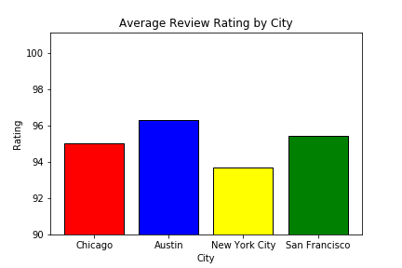
Data Analysis
Which cities have the highest rated Airbnbs?
Just like the last question, this question was easy to answer thanks to the dataset we got.
Highest average rating: Austin
Lowest average rating: New York
Even though there are highest and lowest average ratings, all four cities are actually very close in average rating.

Slide 13
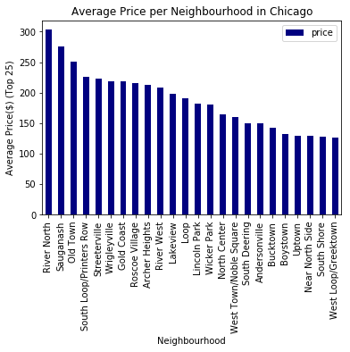
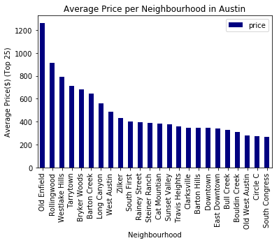
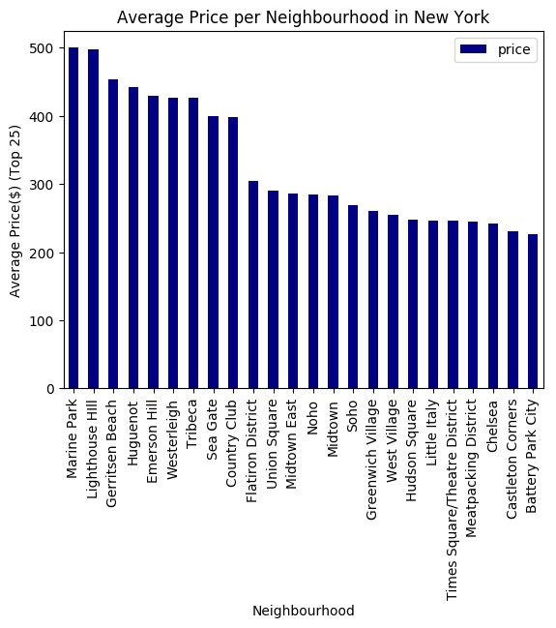
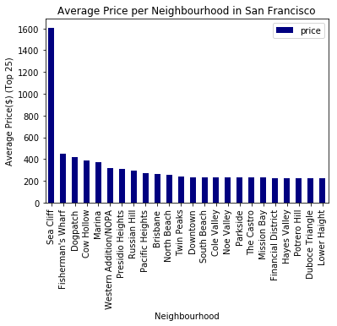
Data Analysis
Which neighborhoods in each city were the most expensive?
This one was tricky to get together because of how the datasets were made. We had to first get average prices for each neighborhood listed, then sort them in descending order.
We also had to compact the data into a top 25, due to certain cities having hundreds of neighborhoods listed.
Most expensive: Sea Cliff, San Francisco
$1,607.50 per night
Least expensive: River North, Chicago
$302.90 per night

Slide 14
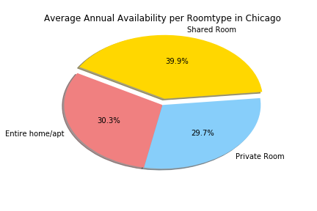
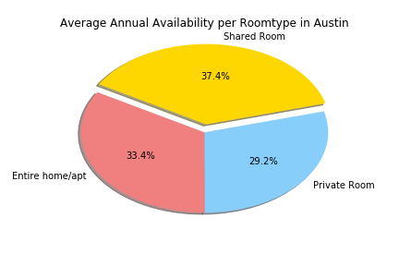
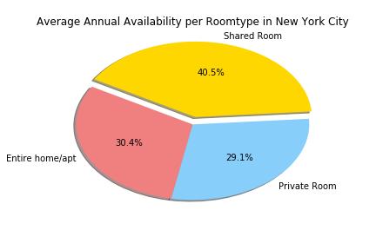
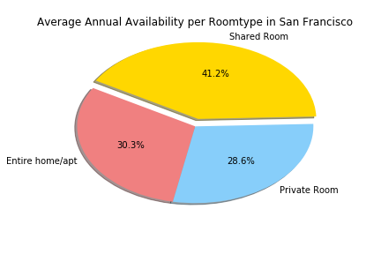
Data Analysis
How available are each city’s Airbnbs?
For this statistic, we decided to also sort average availability by room type, since we wanted to find out if certain room types were more available on average than others.
Average availability the past year:
Chicago: 164 days
Austin: 141 days
New York: 162 days
San Francisco: 117 days

Slide 15
Discussion
We were surprised to see that Austin was so expensive and highly rated compared to the other cities.
This is likely because Austin is not only a nice vacation destination for the nature-lover, but it is also home to the University of Texas. The combination of these two will likely drive up prices for Airbnbs.
Overall, we can say that in the past year people who used Airbnb:
Paid the most in Austin on average and also liked Airbnbs in Austin the most.
Pay more for Airbnbs that are located in high-income neighborhoods and/or near popular visitor destinations like near beaches, popular locations, or places with a good view.
Preferred private rooms or entire homes/apartments than shared rooms.

Slide 16
Aftermath
There were many difficulties we faced with this project. The biggest was finding a usable dataset for our analysis.
While it took a long time to find a workable dataset, we were lucky to find an incredibly detailed dataset for our project.
As we worked on the project, more curious questions came up that we simply either didn’t find the data for or we ran out of time.
How did the Airbnb prices change over time?
How did these Airbnb prices and ratings compare to the prices and ratings of nearby hotels?

Slide 17
Questions?

